Slide 1

Observing the Anthropocene
— The Geology of Humanity
James PM Syvitski
IGBP Chair

Slide 2

Humans have:
  Intervened against gravity
  Decelerated & accelerated natural processes
  Focused energy
  Altered / destroyed ecosystems
  Altered Earth’s —
  climatology
  chemistry
  snow cover
  permafrost
  sea ice extent
  glacial ice extent
  ocean volume
  hydrological cycle
Syvitski, 2012

Slide 3
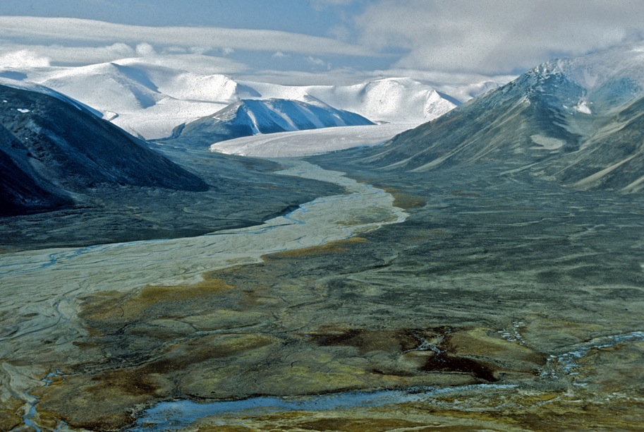
Could the Anthropocene become a geological epoch — where humans have impacted the Earth’s surface so as to result in a global signal in the permanent geological record ???
Epochs reflect stratigraphic ‘events’ — extinctions, tectonics, or bulk changes in the composition of sedimentary rocks.
Is the transition from the Holocene to Anthropocene at the same geological scale as the transition from Pleistocene to Holocene ???
Syvitski, 2012

Slide 4
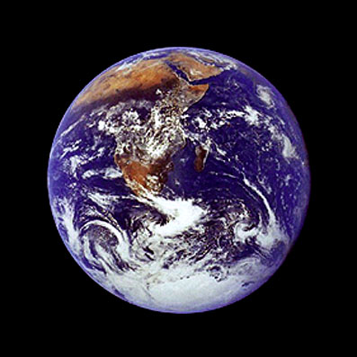
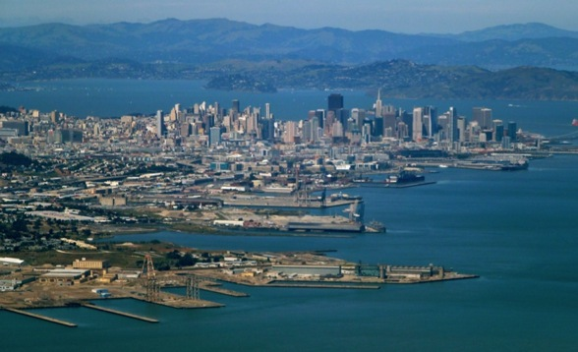
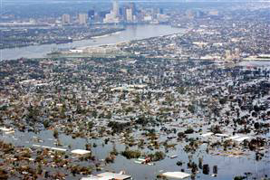
The Anthropocene concept has been in the science literature for 100+ years under various guises, and was formally introduced in 2000 by Nobel laureate and former IGBP VC Paul Crutzen in IGBP’s Global Change magazine.
Syvitski, GEOSS Bonn, 2012

Slide 5
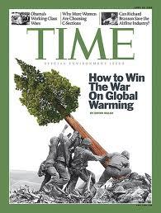
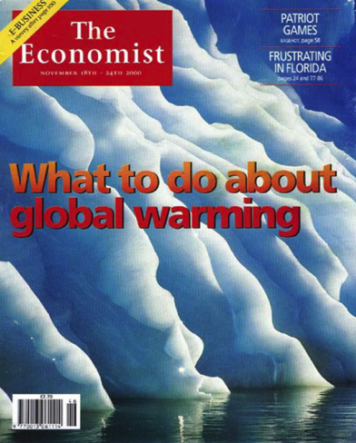
2 of 3 people on earth have heard of Global Warming – Gallop 2008
Yet the Anthropocene is a more effective paradigm to describe the cumulative impact of civilization, making global warming and its consequences just some of the ways in which humans have modified Earth.
Narrow focus on global warming might suggest that we simply need to stop emitting greenhouse gases and use renewable energy to abate the planet’s pressures. The human footprint is much larger than that.
Syvitski, GEOSS Bonn, 2012

Slide 6
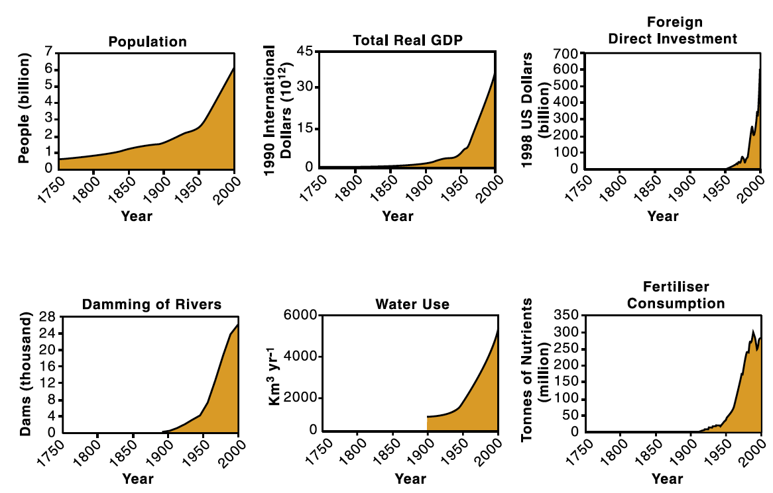
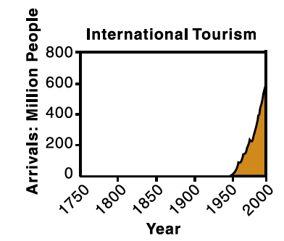

The human enterprise 1750 - 2000: Steffen et al 2007
Syvitski, 2012
Notes:
This great acceleration really started in the 50s

Slide 7
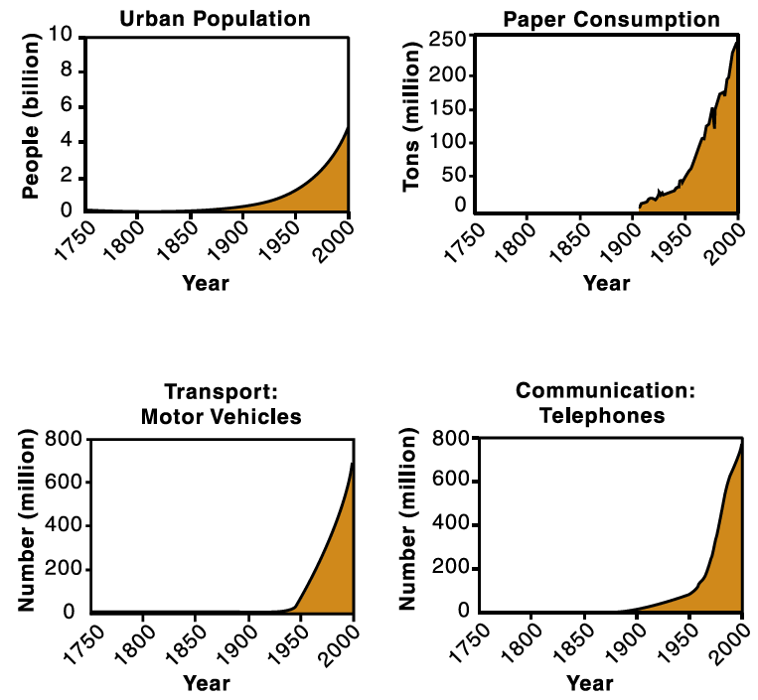
The Great Acceleration began in 1950
The State of the World’s Cities (2001)
IGBP synthesis: Global Change and the Earth System, Steffen et al 2004

Slide 8
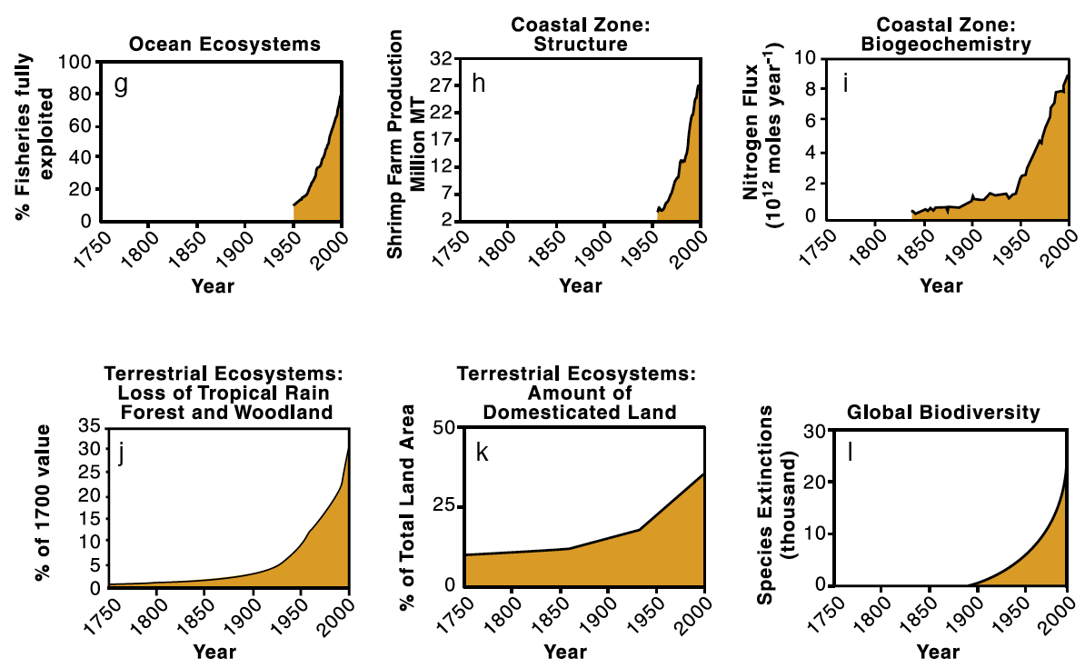
The biophysical Earth System Response
IGBP synthesis: Global Change and the Earth System, Steffen et al 2004

Slide 9
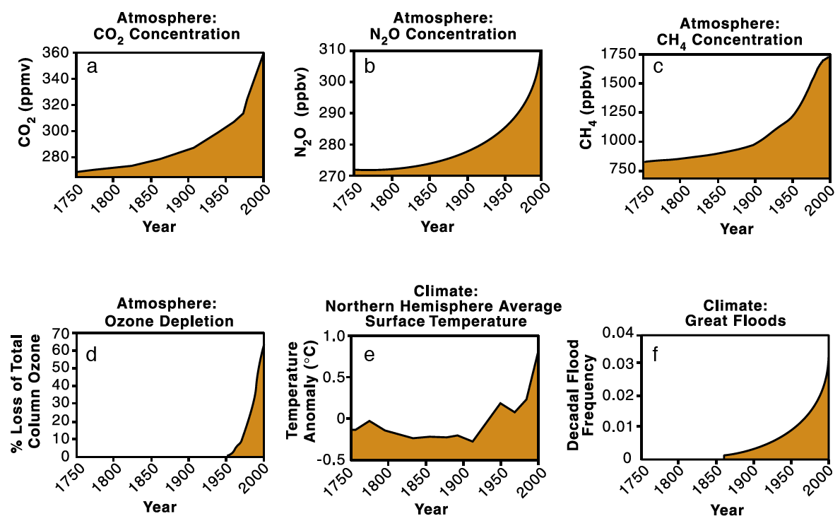
Is the Anthropocene then the beginning of a new geological epoch ???
IGBP synthesis: Global Change and the Earth System, Steffen et al 2004

Slide 10
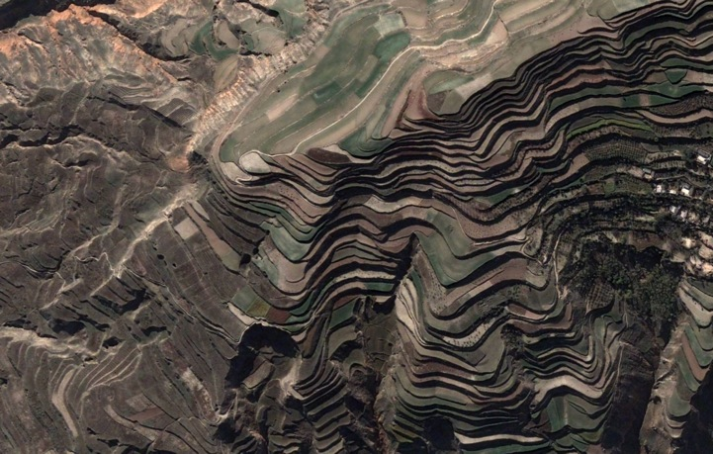
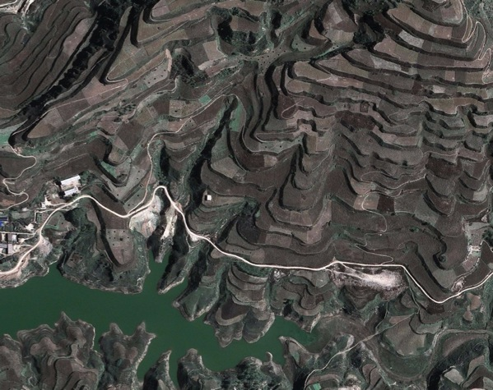
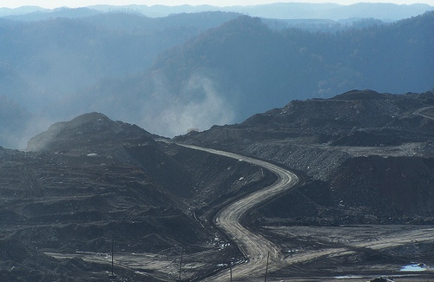
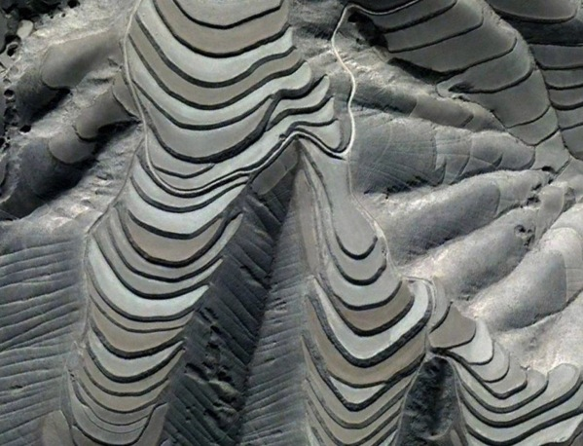
We Sculpture the Earth Surface in many ways
Syvitski, 2012

Slide 11
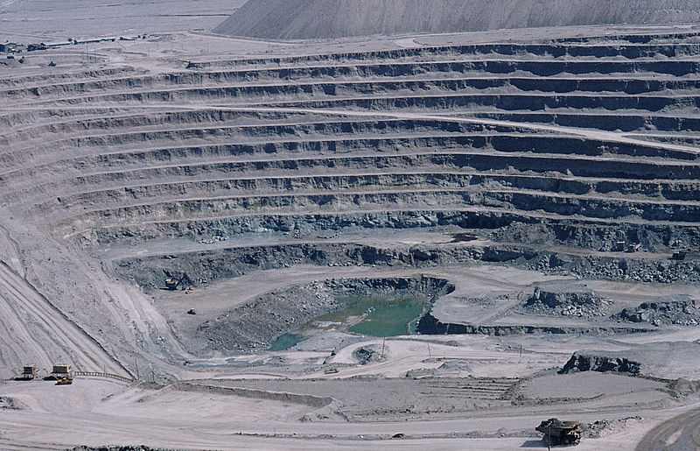
There are 568,000 abandoned mines in the US alone.
Syvitski, 2012

Slide 12
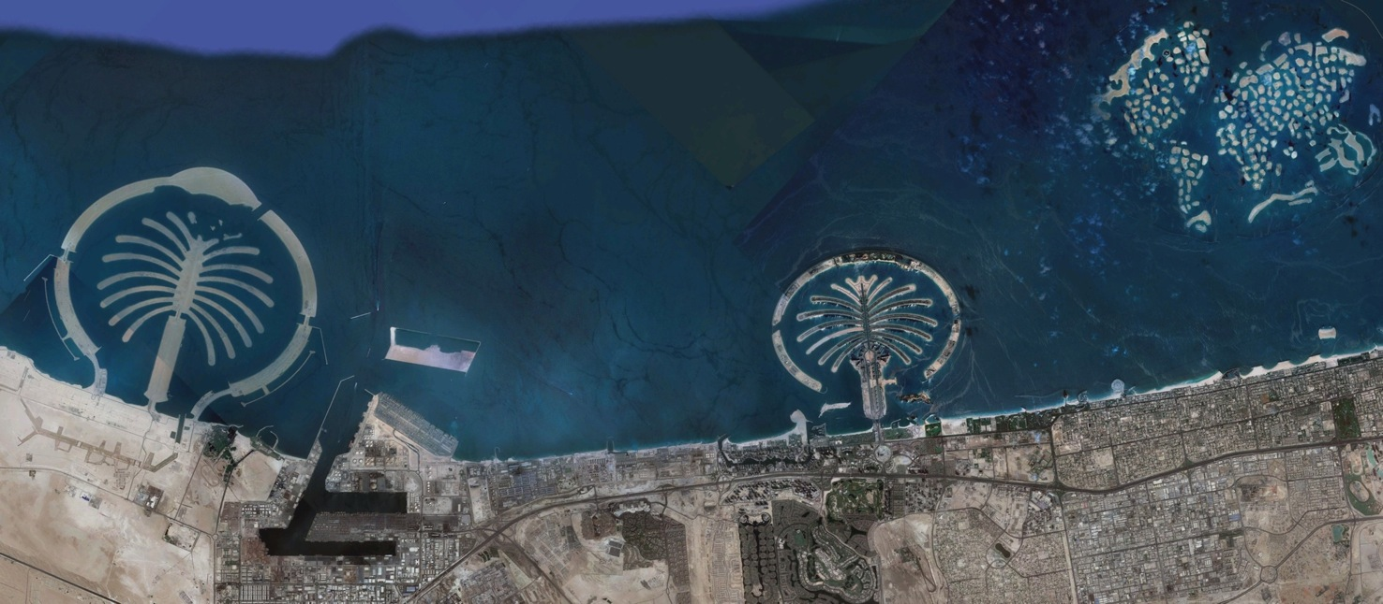
We shape the Earth surface for pleasure or convenience
Palm Jebel Ali Island 0.4 Gt
‘The World’ 0.55 Gt
Palm Jumeirah
Island 0.2 Gt
Palm Deira island (not shown) when completed — 2.0 Gt of sand.
Syvitski, 2012

Slide 13
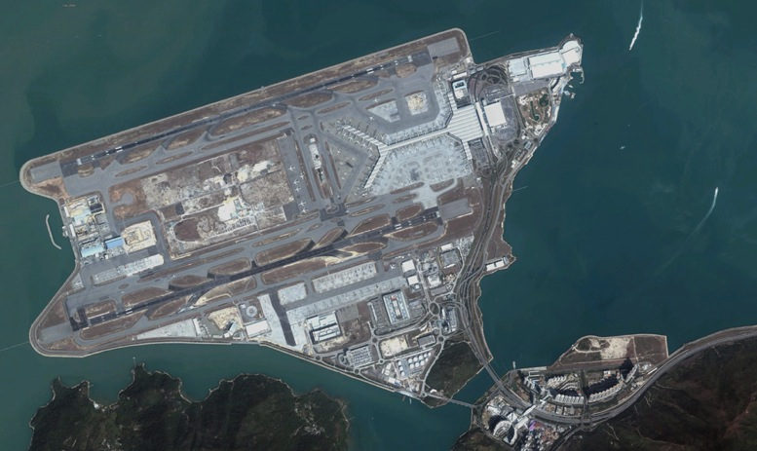
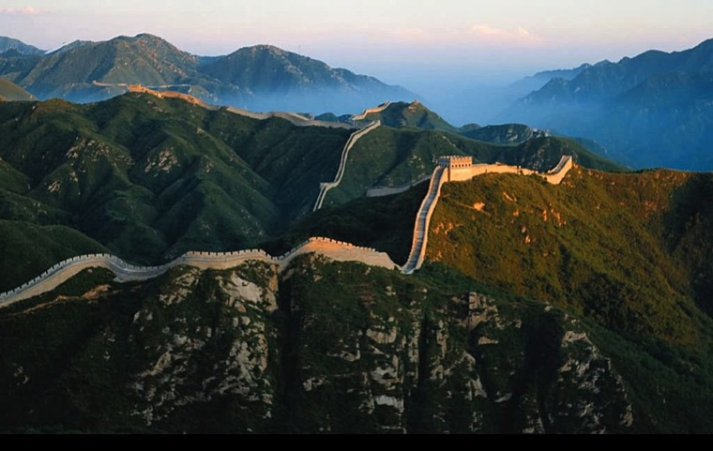
Hong Kong Airport has a surface area of 12.5 km² and comprised of 0.6 Gt of sediment.
How large is 0.6 Gt?
The Great Wall of China is ~6,250,000m x 7m x 5m or ~0.4 Gt of bricks & stone.
Syvitski, 2012

Slide 14
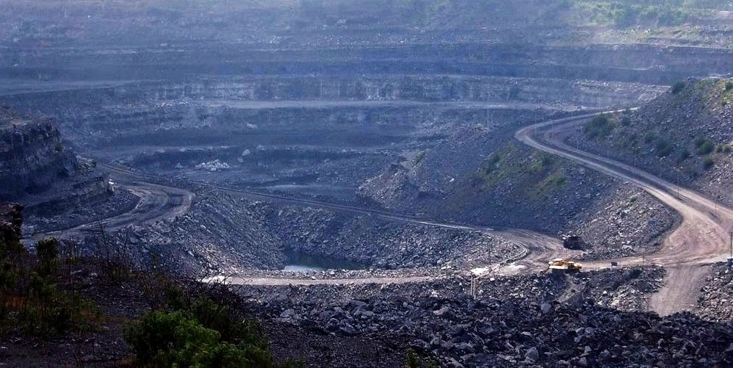
We mine 8 to 9 Gt/y of coal and by 2030 this is expected to reach 13 Gt/y. This equals the total sediment delivery by all rivers to the global coastal ocean.
Syvitski, 2012

Slide 15
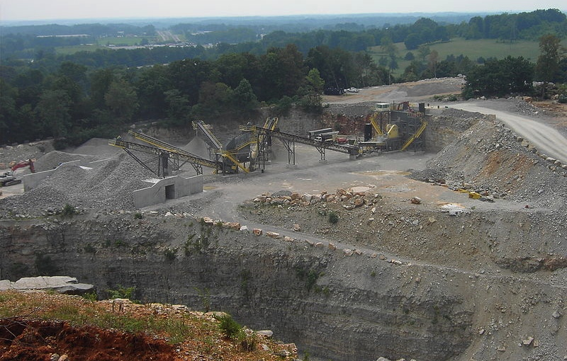
Crushed stone production in the U.S. is 1.7 Gt/y
Sand & gravel mining in the U.S. is 1.3 Gt/y
Globally aggregate production is 13 Gt/y
Syvitski, 2012

Slide 16
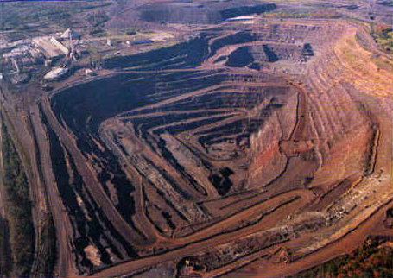
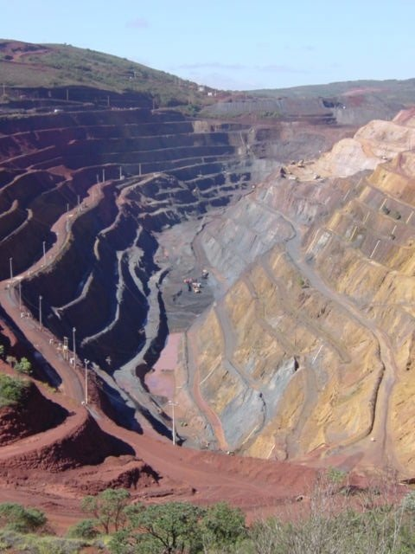
Global hydraulic cement production is 2.2 Gt/y Global iron ore production is 2.2 Gt/y
Humans are now the largest force in the movement of sediment — greater than ice, wind and water.
Syvitski, 2012

Slide 17
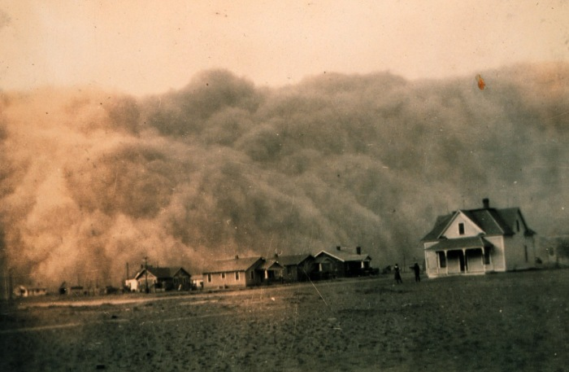
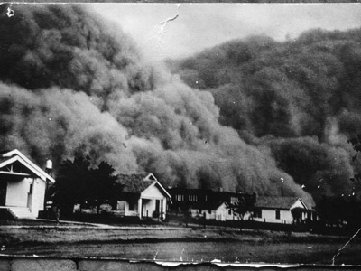
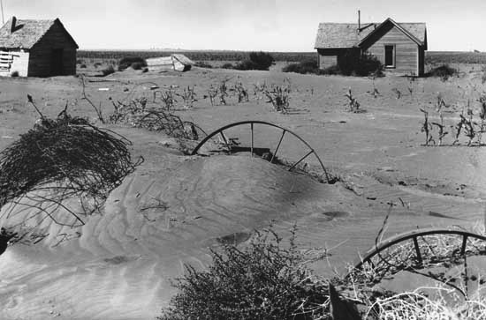
Climate can sometimes amplify the human footprint — The Great American Dust Bowl
proliferation of small farms
poor tilling practice
prolonged drought caused 94,000 km² to lose 12.5 Gt of topsoil in US Great Plains
Syvitski, 2012

Slide 18
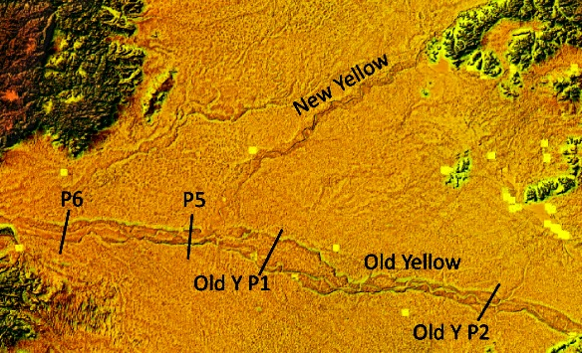
The Yellow delivered an extra 500 Gt of sediment to the coast during the Anthropocene.
Syvitski & Kettner 2011 Phil Trans Royal Soc
The Yellow River once freely migrated across a 700 km-wide floodplain. Humans fixed the Yellow River and as a result a super-elevated river 5 to 20 m above the floodplain built of 50 Gt of river sediment. Chen et al., 2012, Ambio
Syvitski, 2012

Slide 19
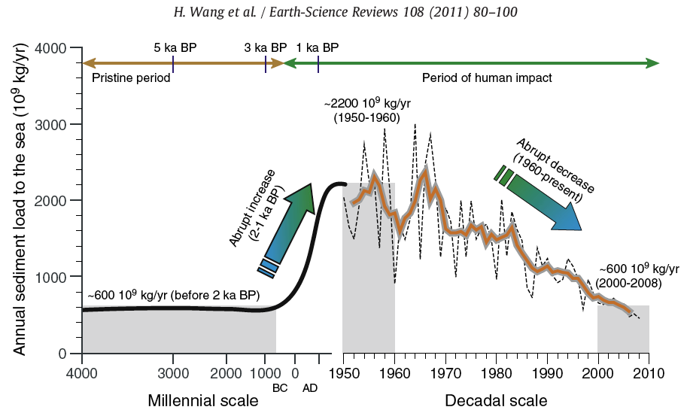
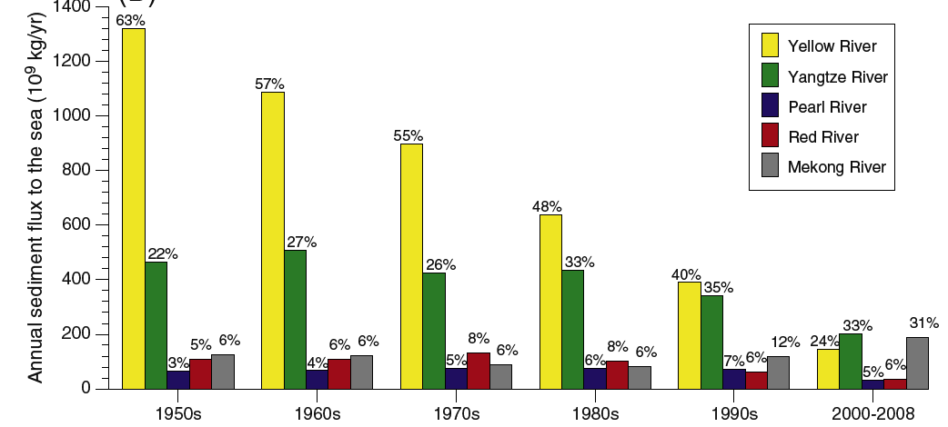
5 Asian Rivers delivered an extra 2000 GT to the coastal ocean due to human activities over the last 1000 years.
Recent dam building has reversed this trend, and reduced the sediment flux to the coast
Syvitski, 2012

Slide 20
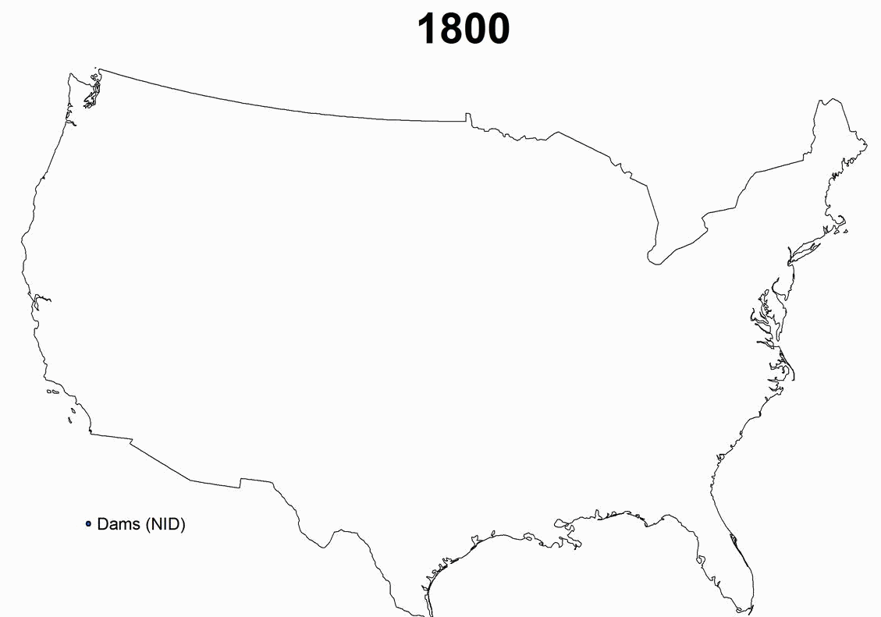
On average we have built one large dam every day for the last 130 years
Syvitski, 2012

Slide 21
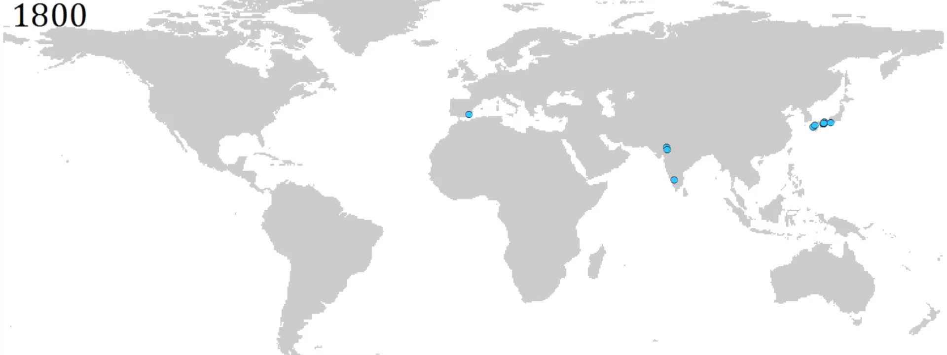
On average we have built one large dam every day for the last 130 years
Syvitski, 2012

Slide 22
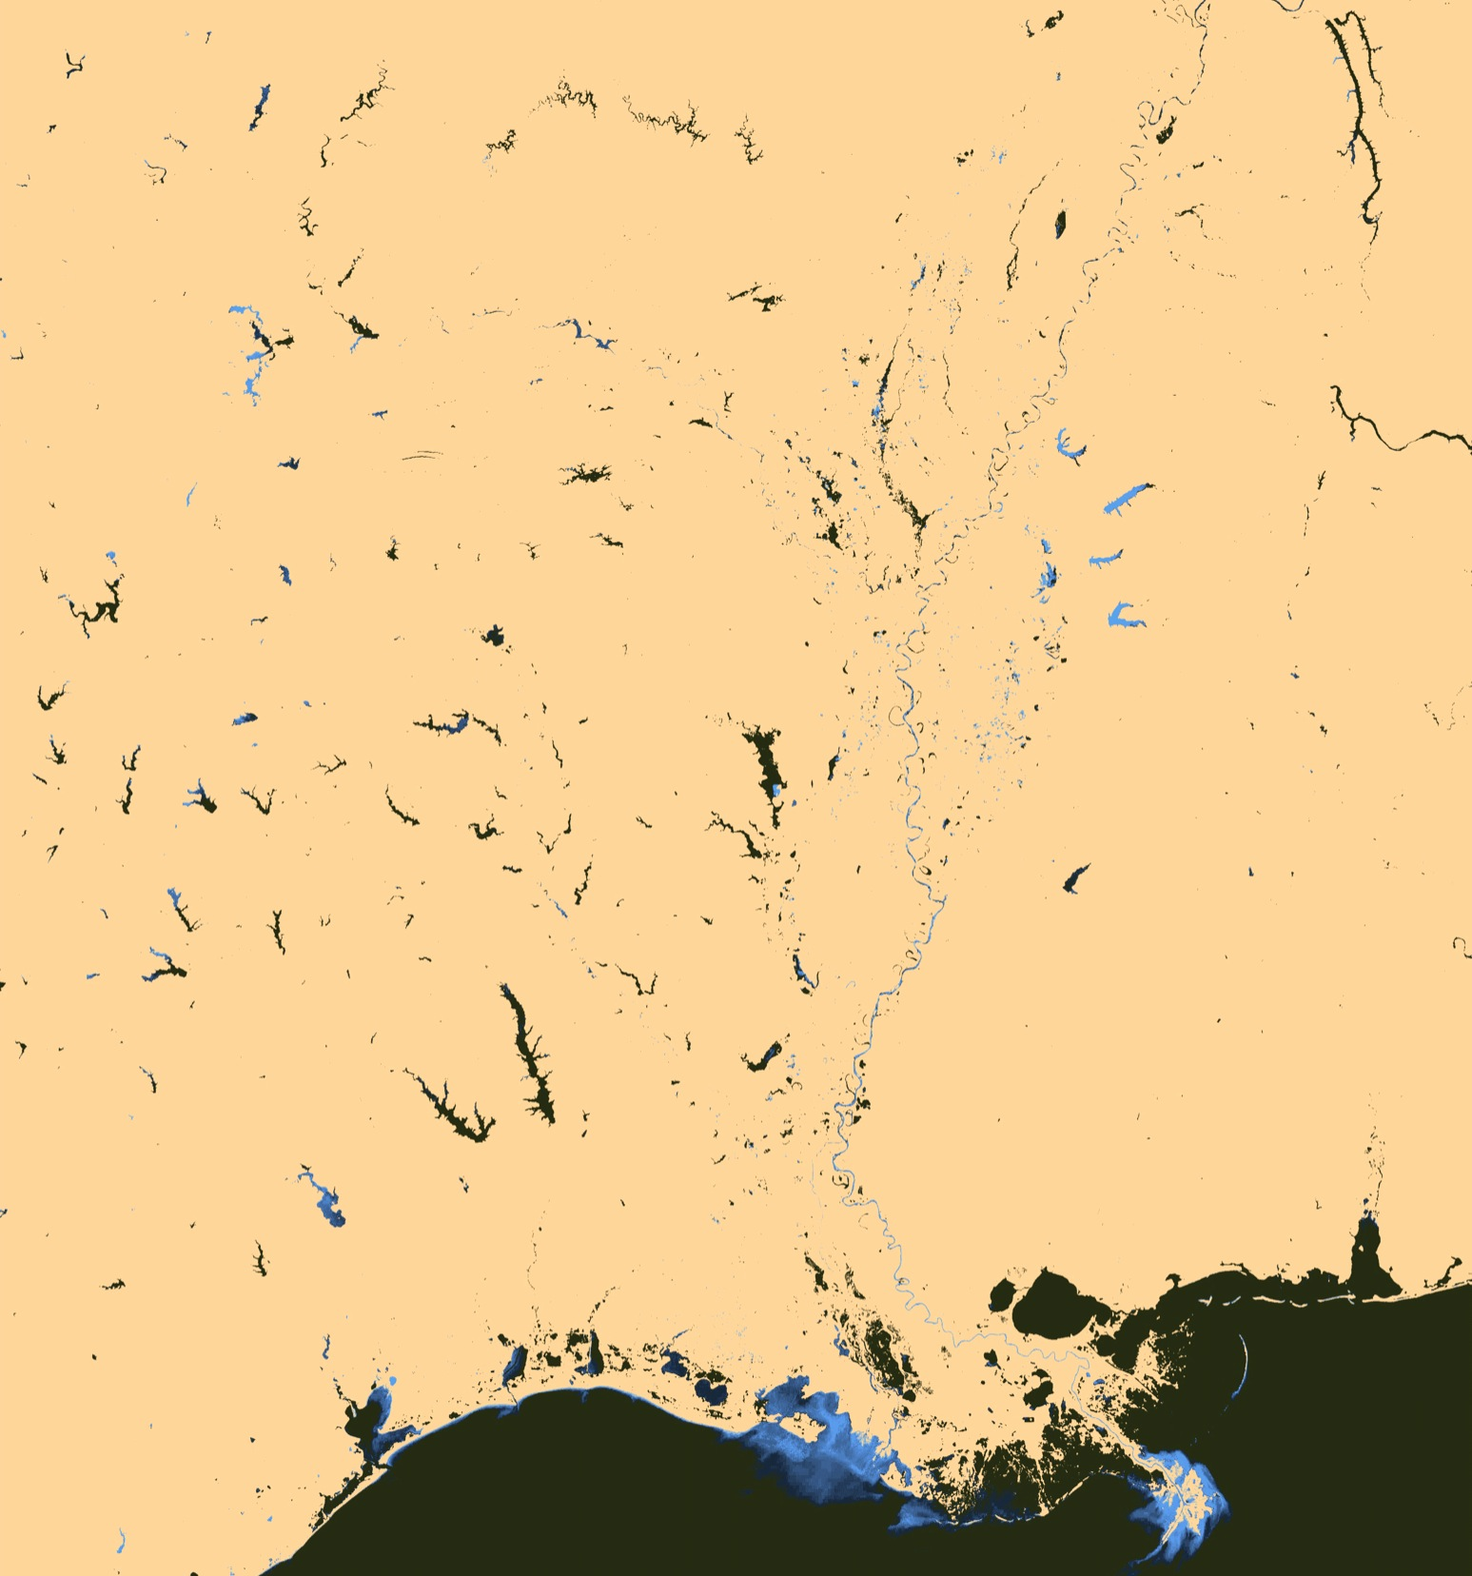
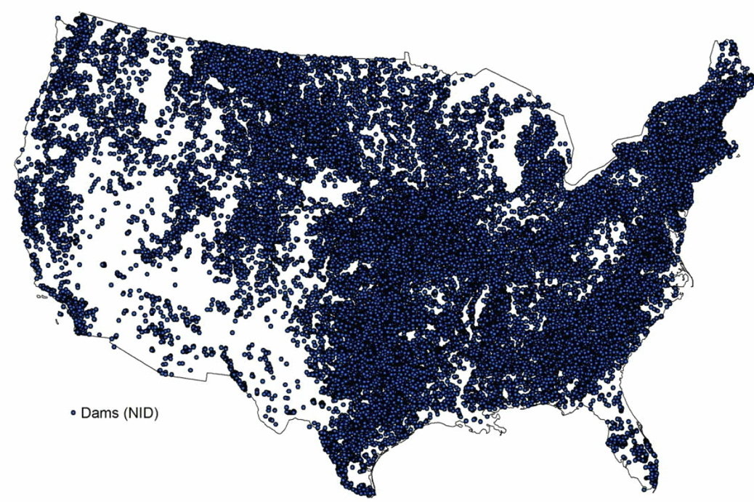
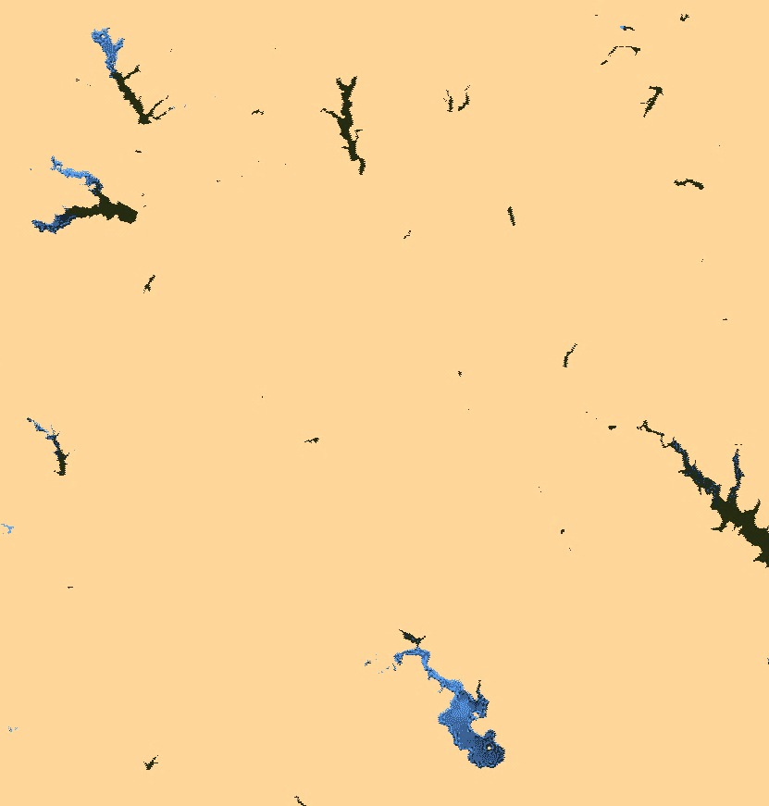


2003
Reservoirs cause more than 2.3 Gt/y less sediment to reach the coast worldwide

Slide 23
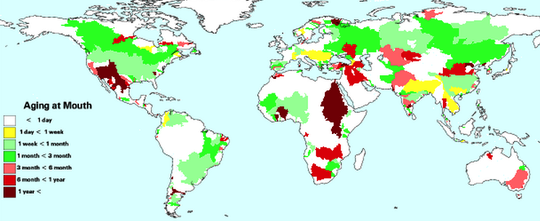
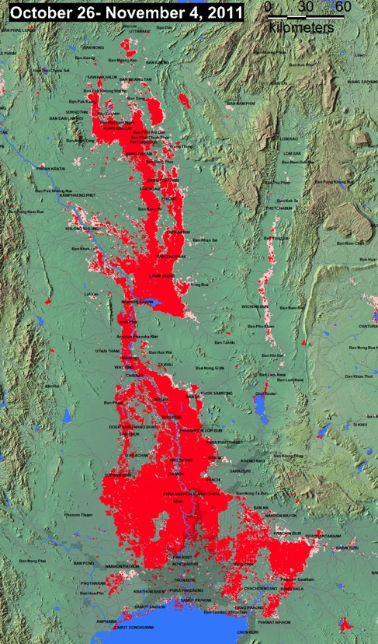
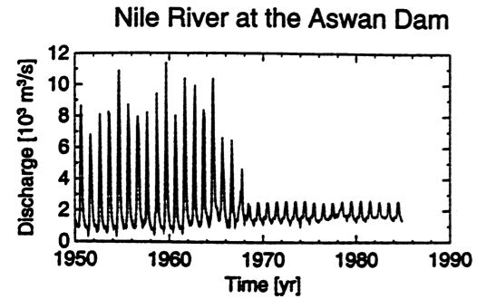
In the Anthropocene we have distorted a river’s natural flow with delays, diversions, storage — providing for unusual hydrographs and floods
Stored Runoff
< 2% annual flow
2
10
25
50
100
> 100%
Syvitski, 2012

Slide 24
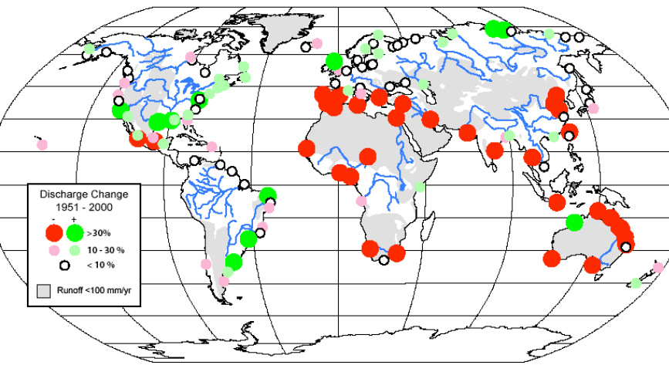
Indus
Our coastal zones receive much less water than during the Holocene.
108
Evaporation
Domestic Use
Indus at
Guddu
3
1
56
Evaporation
Canal Diversions
4
52
22
27
6
Diversion to Fields
1
Groundwater Recharge Discharge
17
River Losses
4
8
11
2
Crop Use
45
Soil Evaporation
Evapotranspiration
SEA
Water Balance (km³) for the Sindh Province:
after Azad 2003, FAO
Milliman, 2008
Consequences include:
Reduced biodiversity; Reduced coastal nutrients; Saltwater intrusion & saline soils;
Increased coastal salinity & temperature; Reduced water transportation
Syvitski, 2012

Slide 25
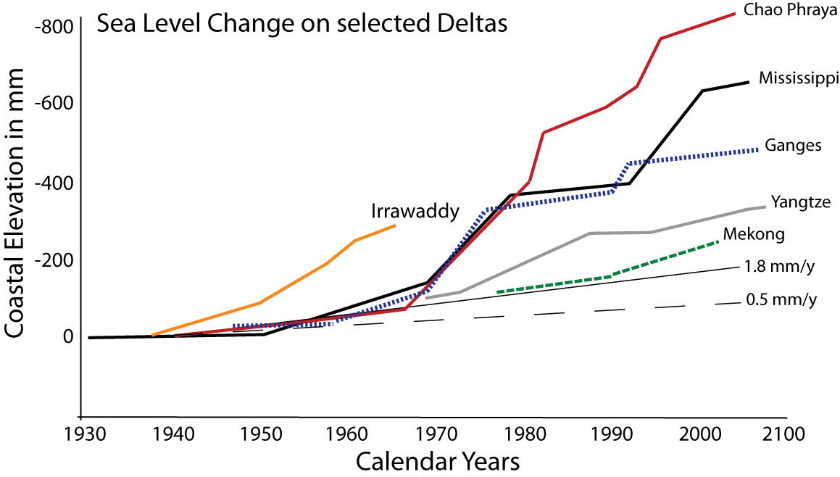
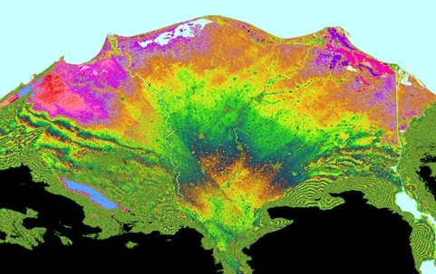
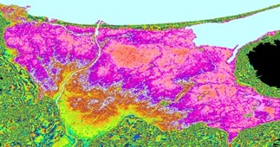
Humans are sinking deltas 4x faster than SL is rising.
Nile
Vistula
Syvitski, 2012

Slide 26

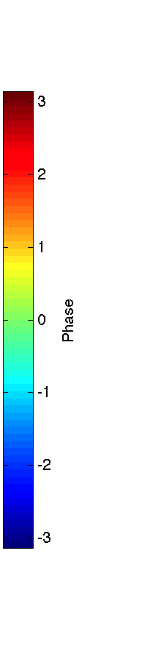
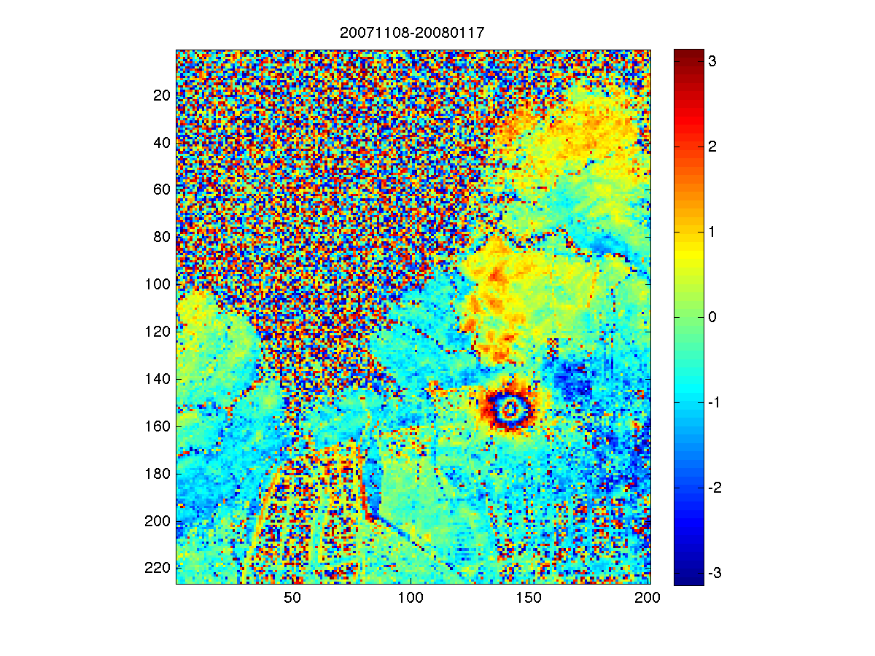
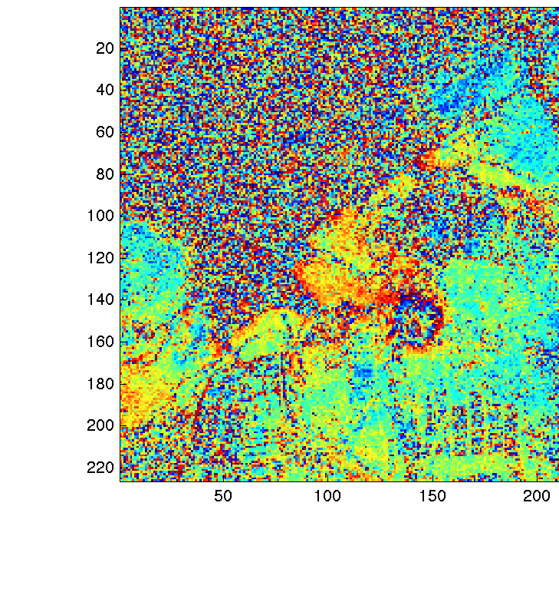
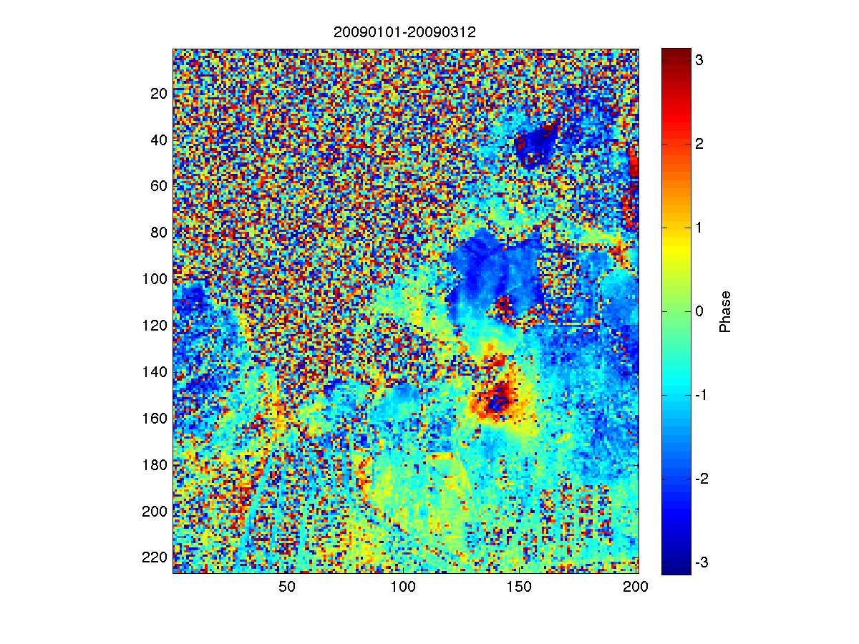
Spring
2007:
5 cm
in 70 days
Winter 2007-2008:
6 cm
In 70 days
Subsidence rates of up to 24 cm/y have been measured on the Yellow Delta — the biggest culprits are shallow groundwater withdrawal for tonguefish farming, oil extraction, and compaction.
S. Higgins, CSDMS, 2012
Jan – March 2009:
2.5 cm
in 35 days
Syvitski, 2012

Slide 27
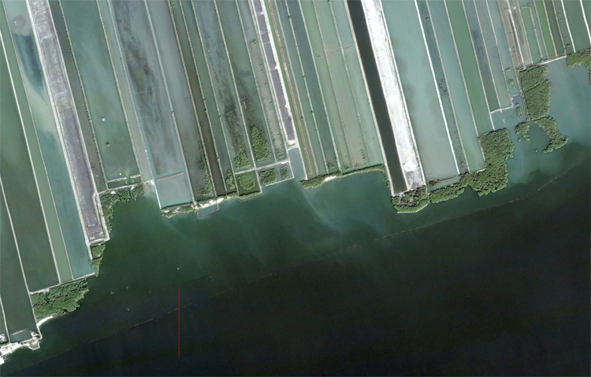
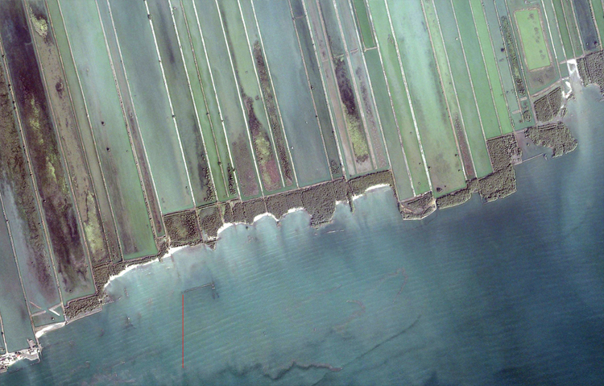
250 m
2008
2001
The reduction in coastal mangroves and proliferation of shrimp farming have together accelerated the rates of coastal erosion.
Syvitski, 2012

Slide 28
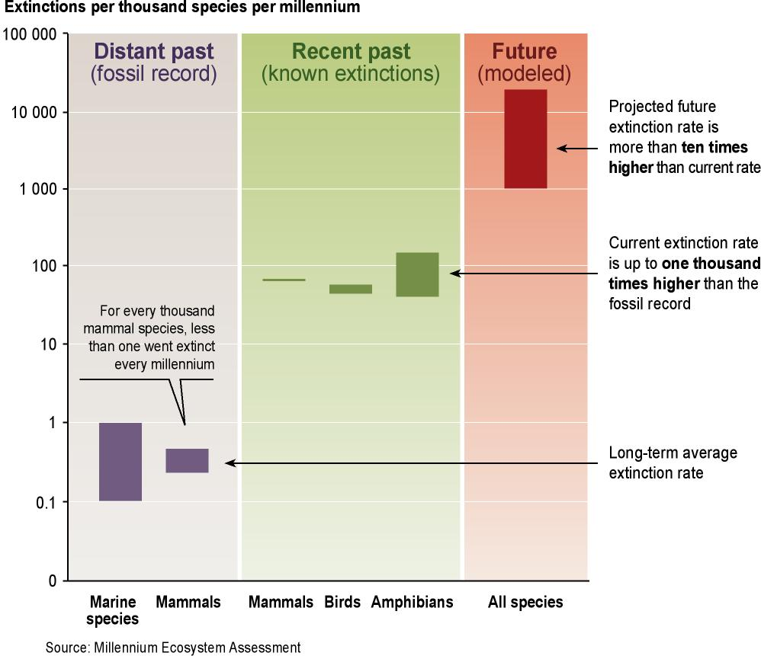
Biodiversity in the 21st century
  Humans have increased the species extinction rate by 1,000 times over a background typical of the planet’s history
  10–30% of mammal, bird, and amphibian species are currently threatened with extinction
Source: Millennium Ecosystem Assessment 2005
Syvitski, 2012

Slide 29
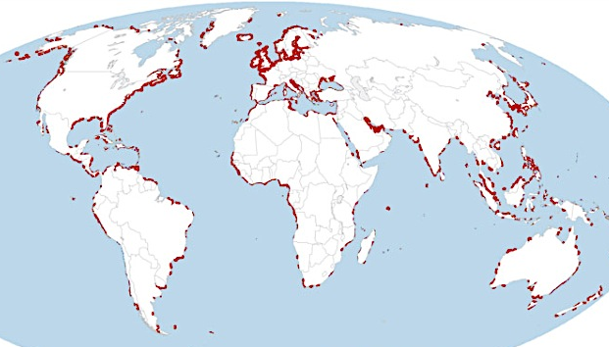

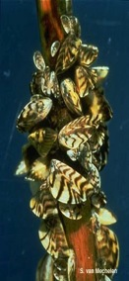



Global radioactive signals
Invasive
coastal species
Irrigation
of
deserts
Ocean acidification
Monoculture ecologies
Syvitski, 2012

Slide 30


Syvitski, 2012

Slide 31


Welcome to the Anthropocene
Syvitski, 2012

Slide 32
Syvitski, 2012

